Slide 1

Employee Data Analysis using Excel
STUDENT NAME: Dheepakkumar A
REGISTER NO: 312206415
DEPARTMENT: COMMERCE
COLLEGE: AGURCHAND MANMULL JAIN COLLEGE.
1
Notes:
1

Slide 2

PROJECT TITLE
Employee
Performance
Analysis using
Excel
2

Slide 3



AGENDA
Problem Statement
Project Overview
End Users
Our Solution and Proposition
Dataset Description
Modelling Approach
Results and Discussion
Conclusion
3/21/2024 Annual Review
3

Slide 4

PROBLEM STATEMENT
This analysis is created to track the performance of the employees, in order to provide promotions, incentives to the respective employees.
This analysis helps the organisation to grow by the growth of the employees of the organisation.
4

Slide 5

PROJECT OVERVIEW
.
Employee Performance Analysis is created to analyse all the data like attendance, gender, age, high, medium, low, very high skilled employees of the organisation.
5

Slide 6

WHO ARE THE END USERS?
Employees
Managers
Employers
Managerial organisations
Industrial organisations
6

Slide 7

OUR SOLUTION AND ITS VALUE PROPOSITION
Conditional formatting - missing
Pivot tables - summary
Charts – trend
Filtering and Formula - performance
Graph – data visualization
7

Slide 8
Dataset Description
Employee = Kaggle
26 – Features
9 - Features
Employee id – numerical values
Name – text
Employee type
Performance level
Employee rating – numerical values

Slide 9

THE "WOW" IN OUR SOLUTION
Performance level =IFS(Z8>=5,”VERY HIGH”,Z8>=4,”HIGH”,Z8>=3,”MED”,TRUE,”LOW”)
3/21/2024 Annual Review
9

Slide 10
MODELLING
Data collection
Downloaded from Edunet dashboard
Data cleaning
Identified the missing values
Filter out missing values
Performance level
Created a formula
Summary
Pivot table
Graph
10

Slide 11
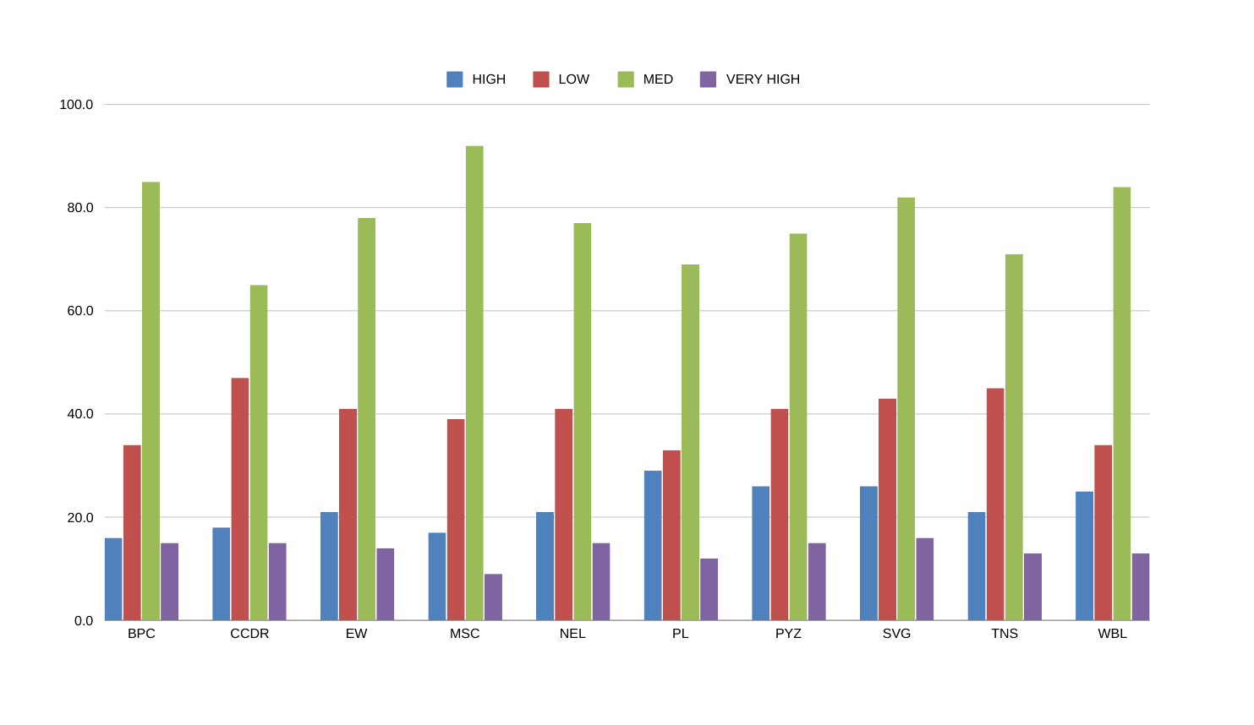
Results
11

Slide 12
Conclusion
While we comparing the performance of the employees, the number of employees are highly performed PL sector of the organization.
We should motivate the employees of the other sectors by giving different kinds of tasks based on their strength, in order to improve the standard of the organization.

